Slide 1

Algorithm Performance Study
Empirical Performance Analysis
Unweighted Set Cover Problem
Method 01
Exact Solver
Integer Linear Programming (ILP)
Method 02
Greedy Heuristic
Deterministic Greedy Approximation
Course
CSC 2400
Design and Analysis of Algorithms
Method 03
Metaheuristics
Genetic Algorithm (GA) & Harmony Search (HS)
Research Authors
Ian Phillips Abdullah Javed Matthew Richardson
Notes:
Good afternoon. Today our team is presenting an empirical evaluation of four distinct algorithmic paradigms for solving the Unweighted Set Cover Problem.

Slide 2
What is the Set Cover Problem (SCP)?
FORMAL DEFINITION
Given universe U = {1, ..., n} and subsets S = {S1, ..., Sm}, select S' ⊆ S of minimal cardinality such that ⋃ Sj = U.
OPTIMIZATION TARGET
Minimize total subsets picked while ensuring 100% element coverage.
NP-HARD COMPLEXITY
Theoretical worst-case complexity forces a critical trade-off between exactness and execution time.
REAL-WORLD APPLICATIONS
Airline crew scheduling, computational biology, cellular tower layout, and portfolio optimization.
Notes:
The Set Cover Problem asks what is the fewest number of subsets needed to cover every element in a universe. Because it is NP-hard, finding exact answers becomes exponentially difficult as problem sizes scale.

Slide 3
Research Questions & Hypotheses
RQ1: SOLUTION QUALITY
Do population/pitch-adjustment metaheuristics (GA, HS) consistently find tighter covers than Greedy on sparse benchmark matrices?
HYPOTHESIS
Yes. Greedy is myopic and susceptible to local traps; GA and HS utilize stochastic operators to escape local optima.
RQ2: RUNTIME SCALABILITY
How do runtimes scale relative to exact ILP as universe size expands to N = 2048?
HYPOTHESIS
Exact ILP will hit an exponential worst-case runtime wall O(2^{m} ), whereas metaheuristics scale predictably within bounded generation/iteration limits.
Notes:
We framed our investigation around two primary questions: can stochastic metaheuristics beat local myopic traps that fool greedy choices, and where exactly does exact Integer Linear Programming become intractable?

Slide 4
Theoretical & Computational Complexity
ILP EXACT SOLVER
Branch-and-Bound / Cuts
Time Complexity: O(2^{m}) worst-case
Traversal: Global search via continuous Simplex relaxation
GREEDY APPROXIMATION HEURISTIC
Myopic Selection
Time Complexity: O(m · n²)
Traversal: Deterministic local myopic reduction
GENETIC ALGORITHM (GA)
Population-Based Metaheuristic
Time Complexity: O(G · P · m · n)
Traversal: Population evolutionary crossover, mutation & repair
HARMONY SEARCH (HS)
Music-Inspired Metaheuristic
Time Complexity: O(K · HMS · m)
Traversal: Pitch-adjustment memory consideration search
Notes:
Here we see our four algorithmic paradigms. ILP gives guaranteed mathematical exactness at the cost of potential exponential runtime. Greedy offers ultra-fast execution, while GA and HS bound runtime via generation limits.

Slide 5
Empirical Results: Beasley OR-Library
Benchmark: scp41.txt | Universe (n) = 200 | Candidate Subsets (m) = 1,000
ILP EXACT SOLVER
0.0391s
Execution Runtime
5 Subsets
0.00% Gap (Optimum)
HARMONY SEARCH
0.0116s
Execution Runtime
5 Subsets
0.00% Gap (Optimum)
GENETIC ALGORITHM
0.9723s
Execution Runtime
5 Subsets
0.00% Gap (Optimum)
GREEDY HEURISTIC
0.0000s
Execution Runtime
6 Subsets
+20.00% Gap (Trap)
KEY FINDING:Harmony Search matched global optimality while executing ~83x faster than Genetic Algorithm.
Notes:
On the standard academic benchmark scp41, the Greedy heuristic got trapped at 6 subsets. Both GA and Harmony Search found the true optimal cover size of 5, but Harmony Search did so in just 11.6 milliseconds.

Slide 6
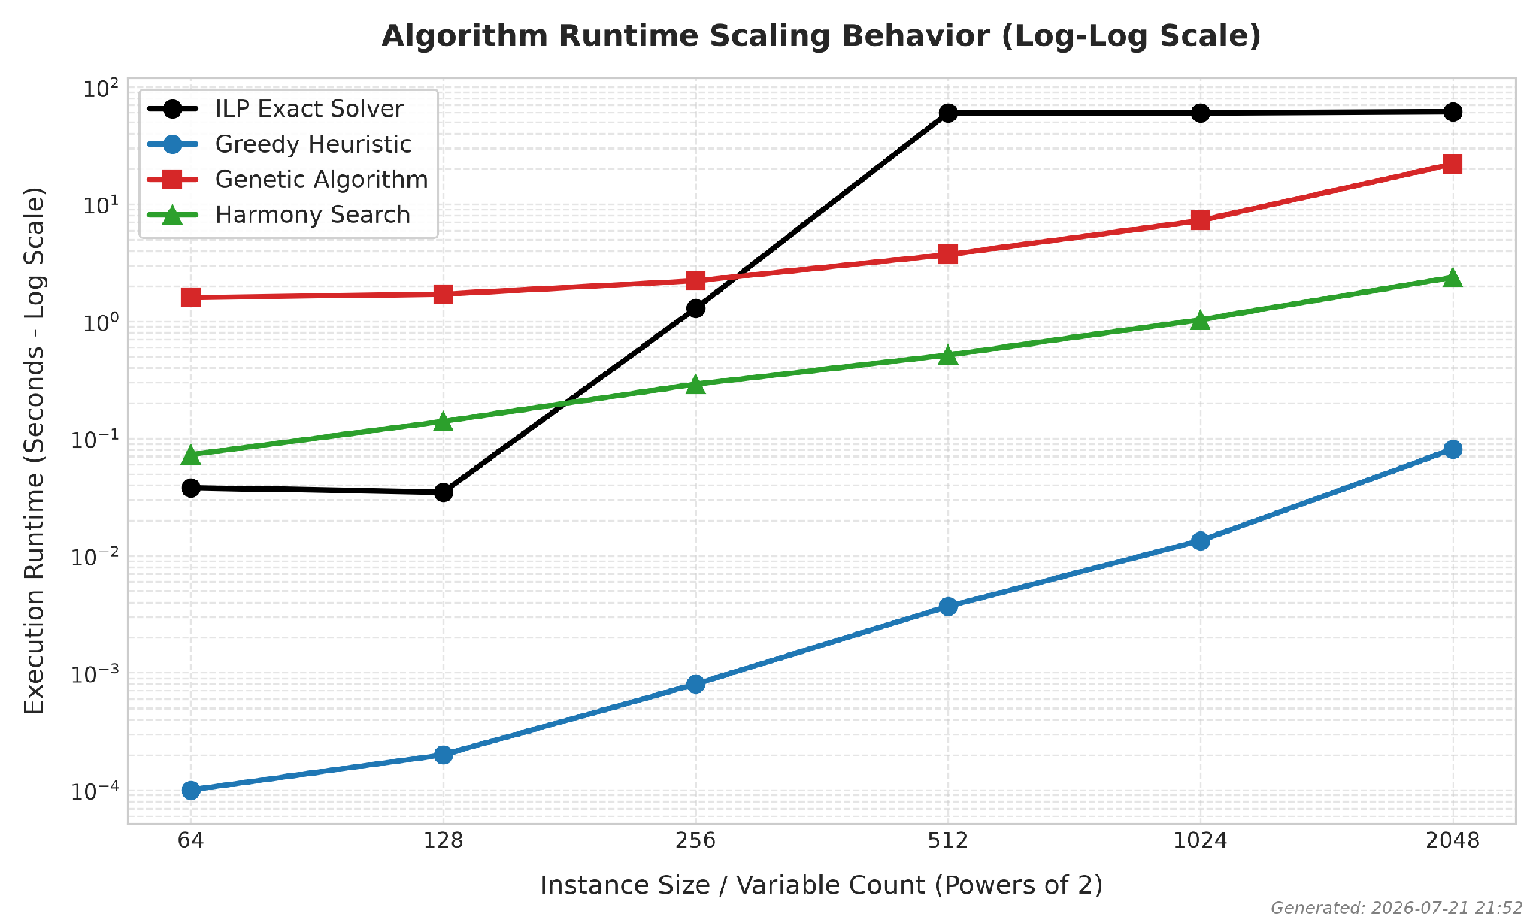
Runtime Scalability: Synthetic Suite (N = 64 → 2048)
ILP INTRACTABILITY CEILING
Solves N ≤ 256 in < 1.5s, but hits 60s timeout at N = 512/1024, becoming intractable at N = 2048.
GREEDY EFFICIENCY
Sub-second runtime across all scales (0.0913s at N = 2048).
METAHEURISTIC BOUNDED RUNTIME
Runtime scaling is strictly bounded by maximum generation limits.
Notes:
Looking at runtime scaling across synthetic datasets, ILP clearly displays its exponential curve, hitting our 60-second safety cutoff at N=512 and failing entirely at N=2048.

Slide 7
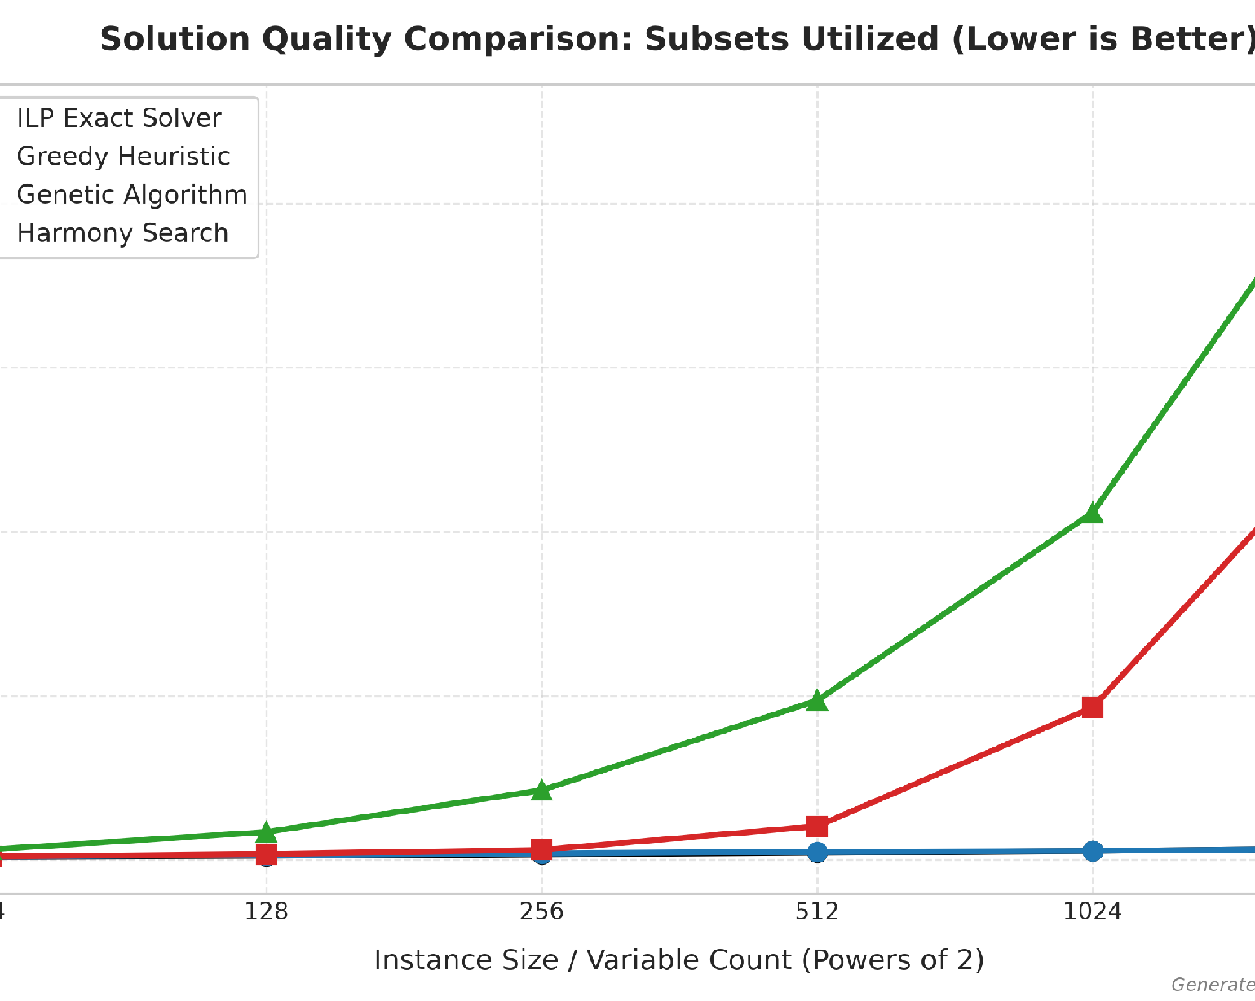
Solution Quality & Search Space Dynamics
GREEDY DOMINANCE (SYNTHETIC GRIDS)
Tracked ILP baseline closely
Demonstrated exceptional performance with a very narrow 0.00% - 20.00% optimality gap.
METAHEURISTIC SEARCH EXPLOSION
Redundant subset accumulation
Standard GA/HS without domain-specific repair pick redundant subsets during feasibility enforcement as N grows.
Notes:
Greedy performed exceptionally well on synthetic data, staying right next to the exact baseline. Un-guided GA and HS suffered from search-space explosion during repair phases on dense matrices.

Slide 8
Trade-off Matrix & Paradigm Selection Guide
EXACT ILP
Branch-and-Bound
BEST USED FOR
Small-to-medium instances (N ≤ 256) where true mathematical minimality is required.
LIMITATION
Unusable for large-scale real-time engineering systems due to exponential runtime growth.
APPROXIMATION
Greedy Heuristic
BEST USED FOR
Dense grids and high-dimensional synthetic systems needing instant execution (< 0.1s).
LIMITATION
Vulnerable to local optimization traps on sparse structured benchmarks.
METAHEURISTICS
GA & Harmony Search
BEST USED FOR
Complex sparse academic instances (e.g., scp41) where local greedy traps exist.
KEY TAKEAWAY
Harmony Search offers faster convergence and lower memory overhead than GA.
Notes:
To summarize the trade-offs: use ILP when you need 100% exact solutions on small problems; use Greedy for real-time results on massive dense grids; and use Metaheuristics on complex sparse structures where greedy choices fail.

Slide 9
Software Architecture & Academic Compliance
System Architecture
Modular Pipeline
Independent Solvers
Modular solver suite including ILP, Greedy, Genetic, and Harmony Search modules.
Pipeline & Metrics
Unified pipeline driver (main.py) with automated CSV metrics logging and visualization (generate_plots.py).
Contributions
Team Breakdown
Ian Phillips
Core Greedy heuristic logic and data matrix parsing.
Abdullah Javed
Harmony Search, ILP engine integration, and plots.
Matthew Richardson
Genetic Search, crossover/mutation, repair loops, pipeline.
Academic Integrity
GenAI Compliance
TTU Guidelines
Utilized Gemini strictly as a pair-programming collaborator for Matplotlib styling, token parsers, and proofreading.
Manual Verification
All underlying algorithmic design logic, parameter selection, experimental execution, and validation of results were reviewed and verified by the team. The human authors remain fully responsible for the correctness and integrity of all outputs.
Notes:
Our codebase was built with strict modular design in Python. In alignment with TTU academic integrity guidelines, Generative AI was utilized strictly for code formatting, visualization styling, and documentation proofreading.

Slide 10
Conclusion & Q&A Session
Summary of Key Artifacts
Project Deliverables
Empirical Benchmark FrameworkComplete empirical coverage across exact, heuristic, and metaheuristic paradigms.
Validated Performance Trade-offsRigorous testing against academic (OR-Library) and synthetic suites.
Reproducible CodebaseModular implementation fully published and accessible on GitHub.
Project Repository
Access Codebase
Unweighted SCP Repo
Session Wrap-Up
Thank You!
Any Questions?
Notes:
Thank you for your time! "What was the point of this whole project?", here is the big picture in plain English:
"Because the Set Cover Problem is NP-hard, there is no single 'best' algorithm for every situation. Our project proved that algorithmic choice is a strict trade-off between time and solution quality. While exact math solvers (ILP) give perfect answers, they hit an exponential computational wall on larger datasets. On the other hand, while complex evolutionary algorithms (GA/HS) sound superior, a simple, ultra-fast Greedy Heuristic often outperforms them on standard random inputs because metaheuristics suffer when their parameters aren't tuned specifically for larger scales."
Why Does This Matter in the Real World?
Set Cover powers real-world optimization problems such as:
Cell tower placement: Covering every neighborhood with the fewest towers.
Airline crew scheduling: Covering every flight segment with the fewest flight crews.
Database indexing: Covering all search query types with the minimum set of indexes.
Your project gives engineers a practical playbook: Use ILP for small/medium instances, use Greedy for fast real-time applications at scale, and use tuned Metaheuristics when dealing with complex, highly non-linear constraints.

